Slide 1
Ought as an Is
The Econ Playground, 19 January 2021

Slide 2

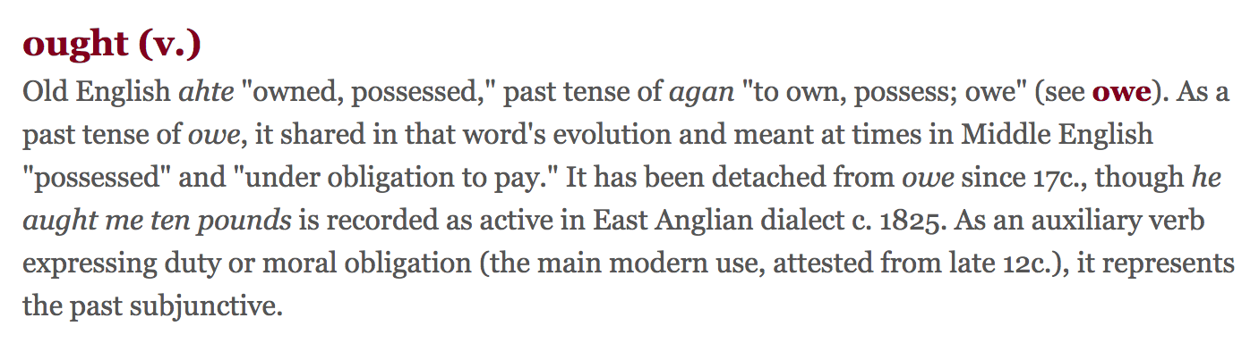



Slide 3
Smith, TMS
“If I owe a man ten pounds, justice requires that I should precisely pay him ten pounds, either at the time agreed upon, or when he demands it. What I ought to perform, how much I ought to perform, when and where I ought to perform it, the whole nature and circumstances of the action prescribed, are all of them precisely fixt and determined.” (Smith 1790, 175)

Slide 4
Ought as a form of owe
Owed to whom?
God

Slide 5
God is good because good is God
English | God | good
Swedish | Gud | god
Norwegian | Gud | god
Danish | Gud | god
Icelandic | guð | góður

Slide 6
“You ought to tie your shoes.”
“It would be good for the whole if you tied your shoes.”

Slide 8
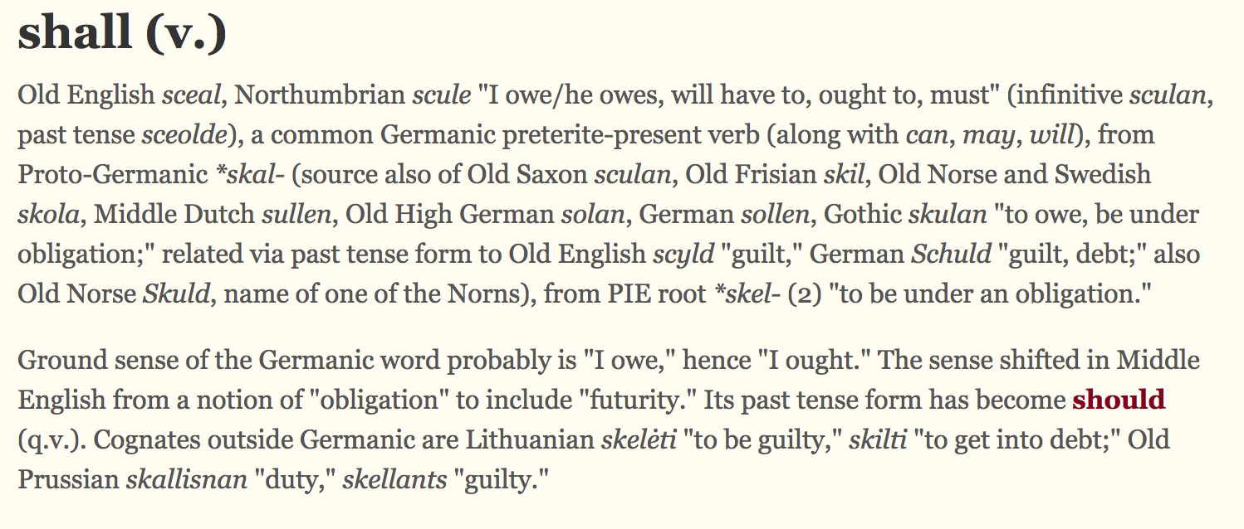





Slide 9
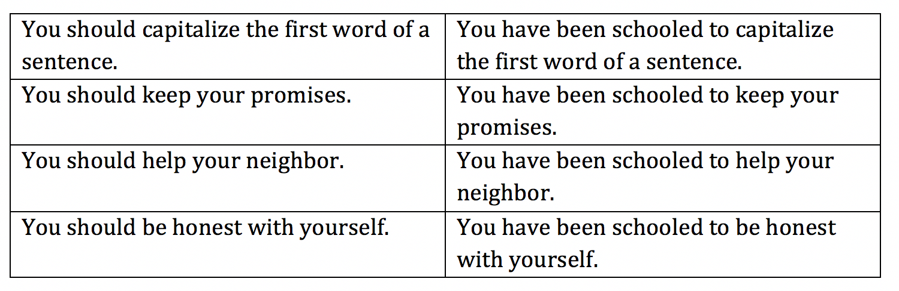
Recasting should as schooled

Slide 10
Statements w/o ought are easily rephrase
“Abilene is in Texas.”
  “You ought to believe that Abilene is in Texas.”
“Murder is wrong.”
  “You ought to believe that murder is wrong.”

Slide 11
Statements w/ ought are easily rephrased
“You ought to honor your mother and your father.”
  “I believe you ought to honor your mother and your father.”
  “The whole will be healthier if you honor your mother and your father.”
  “God wants you to honor your mother and your father.”
  “Sages want you to honor your mother and your father.”

Slide 12
Statements w/ ought are easily rephrased
“Government ought to allow kidney payments.”
  “I believe government out to allow kidney payments.”
  “Social welfare would be enhanced if government allowed kidney payments.”
  “Allowing kidney payments would result in positive net benefits.”
  “God wants the government to allow kidney payments.”

Slide 13
Tacit oughts
When someone reports what the trend of joblessness is, he might also be saying: “We ought not focus so much on what the official unemployment rate is.”
When someone says that black markets and reductions in quality and safety are consequences of drug prohibition or of rent control, he might also be saying we ought not flatten our analysis down to a simple supply-and-demand diagram.
When someone says that a policy reform will tend to have certain dynamic political or policy consequences, or moral and cultural consequences, he might again be saying what things our account of important consequences ought to include.

Slide 14
Tacit oughts
When someone formulates an is sentence, he is suggesting how we ought to formulate matters. When someone says that one of the benefits of raising the tax on cigarettes is that it will reduce smoking, he is also saying that we ought to think of such a consequence as a benefit.

Slide 15
Tacit oughts
An is sentence is an affirmation of the words used in the sentence.
Where Adam Smith (1776) says, “The division of labour is limited by the extent of the market” (31), he is in effect saying that you ought to embrace expressing thinking in terms of “the division of labour,” and in terms of “the extent of the market.”
Where he says, “To remove a man who has committed no misdemeanour from the parish where he chuses to reside, is an evident violation of natural liberty and justice” (157), he is in effect saying that you ought to embrace expressing thinking in terms of “natural liberty.”

Slide 16
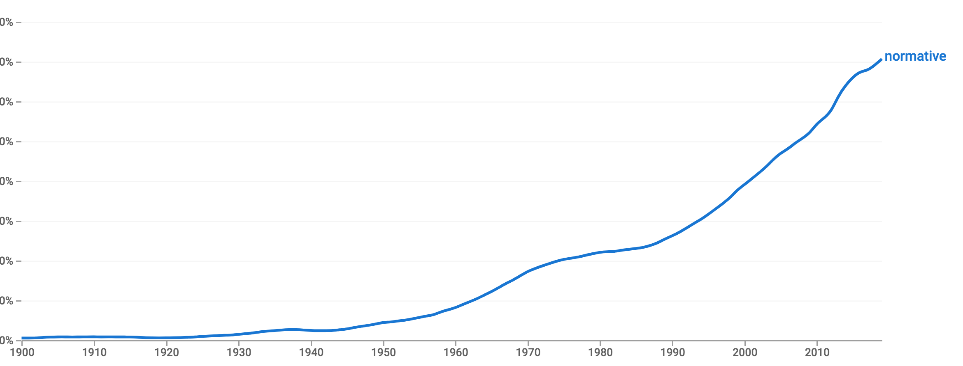
Positive-normative distinction

Slide 17
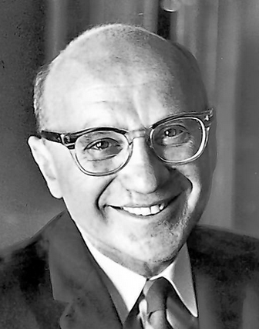
“Positive economics is in principle independent of any particular ethical position or normative judgments. As Keynes says, it deals with ‘what is,’ not with ‘what ought to be’” (Friedman 1953, 4).

Slide 18
The presupposition here:
The presupposition:
That there is some clear or particular distinction between:
  Statements that are not ought statements
  Ought statements
I dispute that presupposition.

Slide 19
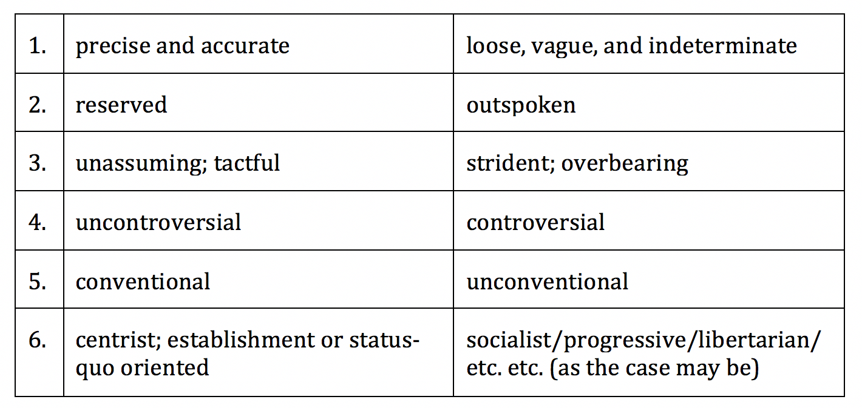
Five other distinctions:

Slide 20
Smith’s remarks on the Encyclopédie edited by Diderot and d’Alembert:
  “…the style of some [entries] is more declamatory, than is proper for a Dictionary; in which not only declamation, but any loose composition, is, more than any where, out of its place.” (Smith 1980,247)

Slide 21
Is pos-norm about the good of the largest whole?
“The discovery of antibiotics advanced the well-being of humankind.”
“Workers deserve to be paid a living wage.”

Slide 22
Embracing positive-normative is a choice!
Options:
  Use it your active vocabulary
  Do not use it in your active vocabulary

Slide 23
Analogy: You are a soccer coach in CloneWorld
A clone series called “Norm Pozz”
Should you put Norm Pozz on your team?
  I suggest, no.

Slide 24
